Slide 1
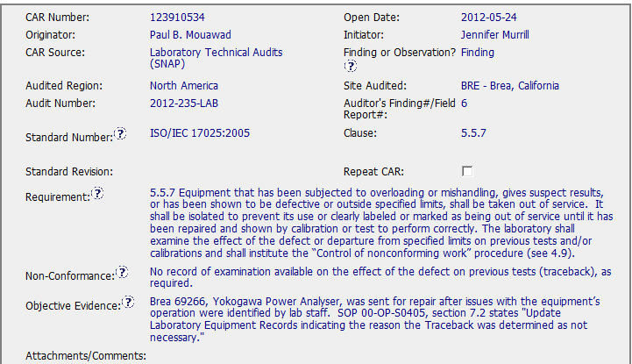
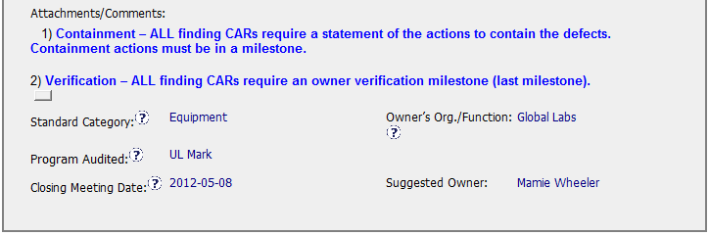
123910534 Exemplary Finding

Slide 2
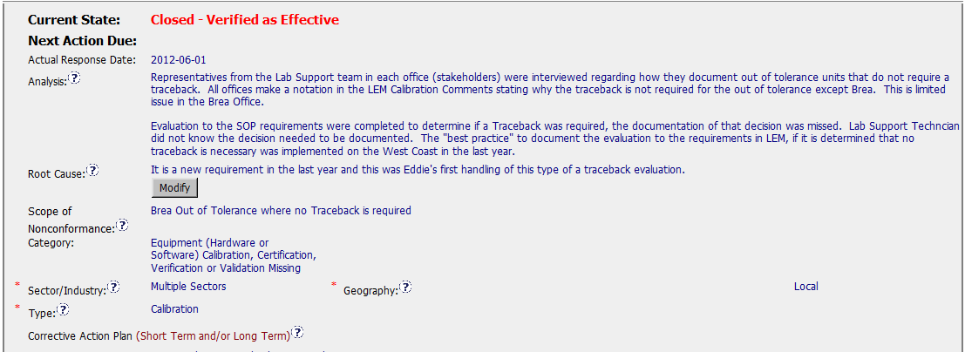
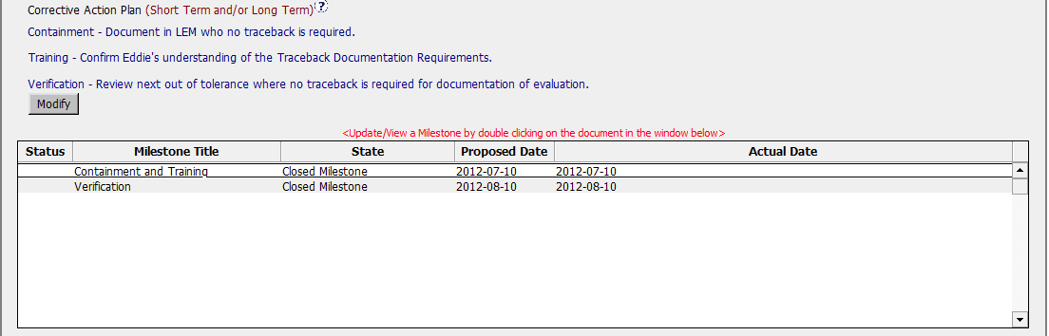
123910534 Exemplary Finding
Clean, clear analysis: shows who was involved, what
specific issue was (where traceback was not required).
RC Statement is clear and concise.
Clear and Concise.

Slide 3
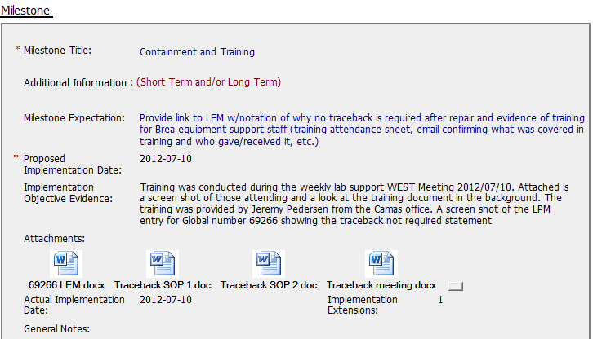
123910534 Containment and Training Milestone
Combined containment and training in 1
milestone. Trained the entire equipment team.
Provided training materials, attendance and
The updated LEM record.

Slide 4
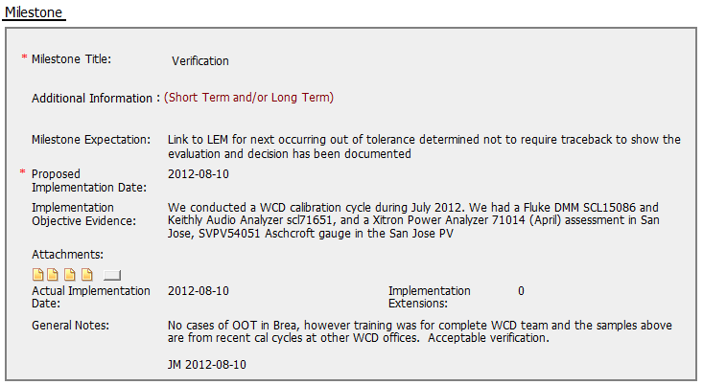
123910534 Verification Milestone
Showed evidence of effectiveness –
Even though no instances for Brea, showed
Other WCD offices who had also received the
Training. Final verification shows a Brea record.

Slide 5
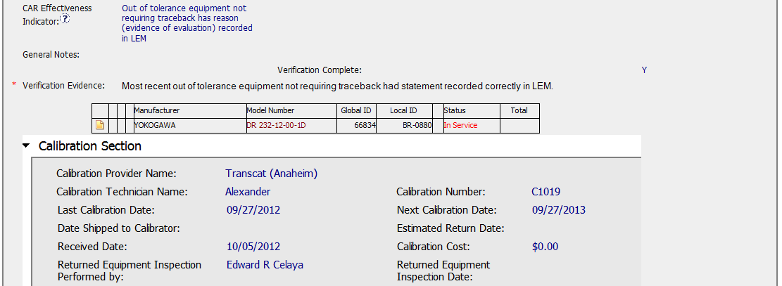
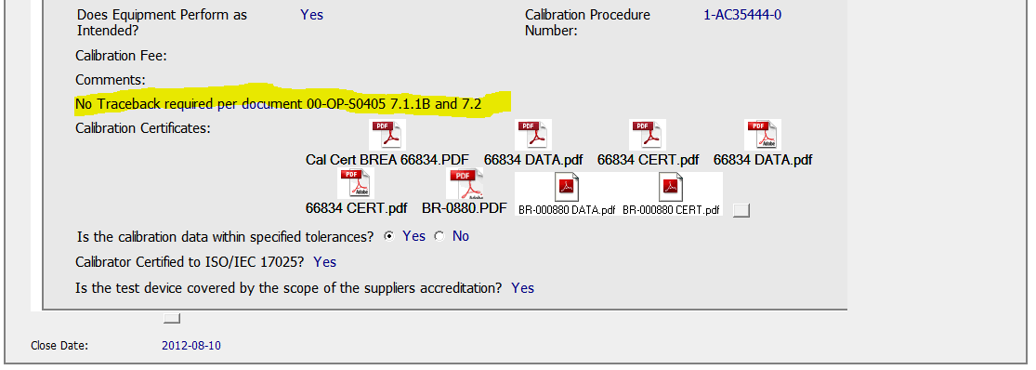
123910534 – CAR Effectiveness
Excellent – showing the LEM Screen shot for verification.

